Slide 1

SDLC Part 3
Spring 2021

Slide 2
1.
SDLC
Software Development Life Cycle

Slide 3
SDLC Part 1
The cycle:
Planning and Requirement Analysis
Defining Requirements
Design Product Architecture
Developing the Product
Testing the Product
Deployment of the Product

Slide 4
Reflecting on Part 2
Design Product Architecture
Developing the Product
What problems did you face?

Slide 5
Reflecting on Part 2
Design Product Architecture
Developing the Product
How many times have you refactored code?

Slide 6
Reflecting on Part 2
Design Product Architecture
Developing the Product
How many times have you created new tasks or changed existing ones?

Slide 7
Reflecting on Part 2
Design Product Architecture
Developing the Product
What can be improved?
What have you learnt?
Notes:
Use these in your final presentation reflections.

Slide 8
Testing
Part 3-A

Slide 9
Testing
Testing to determine if the developed application meets the defined requirements.

Slide 10
Testing
Reflect on what you wrote in SRS
Functional Requirements
Product Functions
Scope

Slide 11
Functional Testing

Slide 12
Genres of Software testing
Functional
Unit testing
Integration Testing
Regression Testing
Positive/Negative Testing
User Acceptance Testing

Slide 13
Unit Testing
Typically done by developers, sometimes by White box testers
Code is written to test every unit of code used to implement functional requirements

Slide 14
Unit Testing
Benefits
Code quality improvement
Detects bugs early
Saves development time
Documentation

Slide 15
Unit Testing
Good Unit test
Checks single Unit of code and not integration
Changing other parts in software should not affect the test
Runs fast
Reusable

Slide 16

Unit Testing

Slide 17
Unit Testing : Question
How likely are these to be unit tests?
“Testing to see if physics works”
“Checking to see if AABB vs AABB works”
“Finding bugs in the level”
“Checking if users can understand the controls”
Notes:
Seems a bit broad and general. Might want to think about testing individual parts of a physics system
This is a function, so testing this function is a unit test.
If there are known bugs, tests can be written to see if they occur. More of negative unit testing.
Not in the scope of work for coders. More for designers. So not a unit test.

Slide 18
Unit Testing
Reflect
What is the cost of unit testing? Can you afford it?
How do you ensure that the unit test is “good”/functional?
Can you afford not to have unit tests? (How do you verify code submitted is in working order?)
Notes:
Writing tests from scratch takes time.
Need to test the test
Does the test truly reflect all functional requirements of the feature?
Do you need to write more tests?

Slide 19
Unit Testing
Two Cents
Generally, there is already a unit test when developing a feature.
Code should already be tested through development.
Code used for testing through development could be used as a unit test. (If there is code)
If this is difficult, think about how to make it easier.
Notes:
Make things easier with better architecture and clear workflows.
“better” for your context.

Slide 20
Integration Testing
Normally done after Unit Testing
Units are integrated and combined, and tested as a combined unit
Goal is to test the interfaces between units
Notes:
While some outputs from one system may seem to work for the next system, others might not.

Slide 21

Integration Testing

Slide 22
Regression Testing
Normally automated
Checks if previous functionalities are still working with new changes added
Regression means testing unchanged parts of the application

Slide 23
Regression Testing
What to do :
Run previously conducted tests
Compare the current results with previously executed results
Frequency :
End of the day
Fix problems the next day

Slide 24
Regression Testing
Scope :
Everything
Priority
Regression test selection

Slide 25

Positive / Negative testing
Positive Testing
Happy Path :D
Normally the first form of testing
Testing using intended inputs, valid data
Tests for intended functionality

Slide 26
Positive / Negative testing
Negative Testing
Error Path ☹
Uses invalid data to tests stability
Requires lots of creativity to execute
Brings out potential flaws
Invalid data?
Any ideas?
Notes:
What do you do with invalid data?

Slide 27
User Acceptance Testing
Done after the system has been thoroughly tested by the production team
Done by users of the product
Ensures that:
Product works as intended
Confidence before releasing into the market

Slide 28
Non-Functional Testing

Slide 29
Genres of Software testing
Non-functional
Performance Testing
Usability Testing
Compliance Testing
Install Testing
…. and many more

Slide 30
Performance Testing
Checks how the application performs under different workloads
Measured by :
Speed
Scalability
Stability

Slide 31
Performance Testing
Load Testing – normal & peak usage
Stress Testing – break the system
Volume Testing – vs data volume
Capacity Testing – future loads
Reliability Testing – return from failure

Slide 32

Performance Testing

Slide 33
Usability Testing
User-friendliness check
System navigation check

Slide 34
Usability Testing
Methods
Hallway Testing – With random people without prior knowledge of the product
Remote Usability Testing
Expert Review
Paper Prototype

Slide 35
Compliance Testing
For the release of software on any platform, there are requirements to be fulfilled.
Examples
Your project submission requirements
Android Development

Slide 36
Install Testing
Making sure the software can be properly installed and works on the target platform(s)
Uninstalling the software should be easy and clean too

Slide 37
Install Testing
Major Concern – Time
Installations can take some time to complete
This would limit the number of times this test can be carried out
Mitigation – Automate the process

Slide 38
Testing
Roles and Tech

Slide 39
Ever heard of SDET?
Software Development Engineer in Test
https://www.tutorialspoint.com/what-is-sdet-explain-full-form-meaning-role-and-responsibilities#:~:text=SDET%20or%20software%20Development%20Engineer,%2C%20Adobe%2C%20Amazon%2C%20etc.
Notes:
The role that was very coveted during my time in Redmond. Seemed be meant for the cream of the crop.

Slide 40
Automation
There are tools to help
Find crashes
Suggest fixes
Output validation
Generate tests

Slide 41
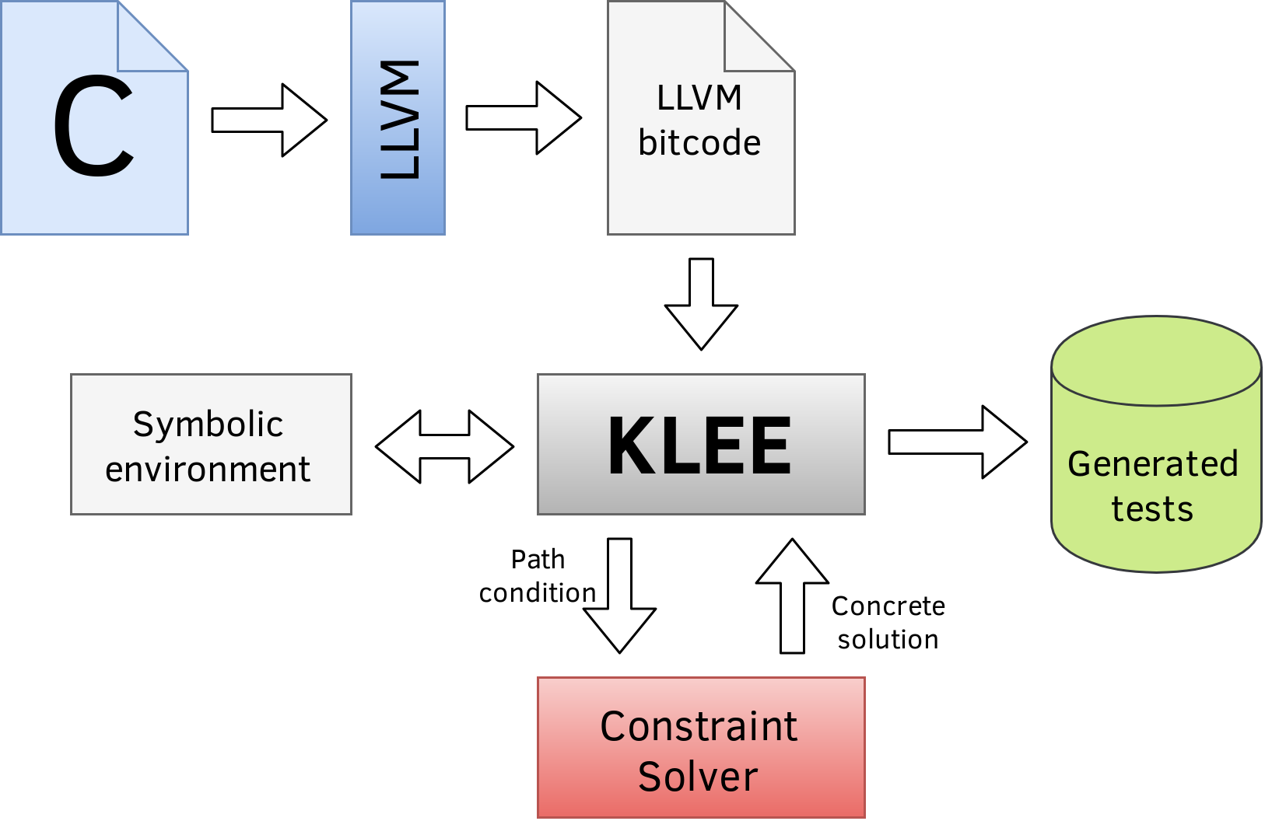
Tool : KLEE
https://verificaeconvalida.gitlab.io/gitbook-appunti/KLEE.html

Slide 42
Further reading
Good professor I met during my masters
https://abhikrc.com/
Notes:
Fuzzing seems to be the trend now.

Slide 43
Deployment
Part 3-B

Slide 44
Deployment
Deploying the software into the target environment.
This may be done in phases:
Platform exclusivity
Different regions, based on scalability of software

Slide 45
Is this the end?
Software may need to be updated regularly
To work on the platforms after operating system updates
When certain systems are obsolete and no longer functioning

Slide 46
Dev Ops (Development and Biz Ops)
Software as a service
Servicing existing clients, maintaining current features
Developing new features, perhaps for new clients
CI/CD workflow (Developers)
Agile

